Slide 1
Audiobooks
UM Libraries

Slide 2
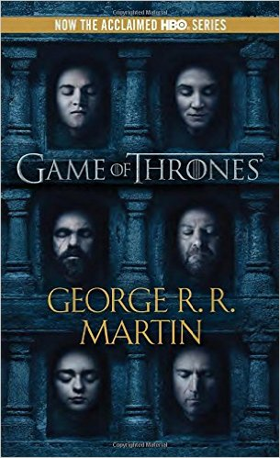
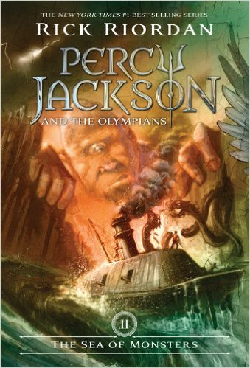
Fantasy
UM Libraries

Slide 3
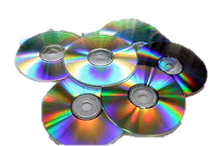
UM Libraries
We have audiobooks
on CD

Slide 4
celebrities
UM Libraries

Slide 5
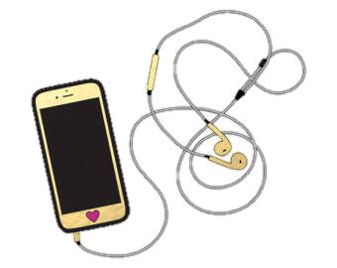
UM Libraries
We have audiobooks
online

Slide 6
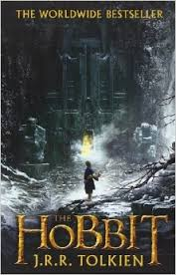
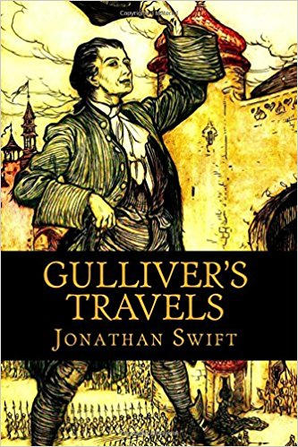
Classics
UM Libraries

Slide 7
UM Libraries
Audiobooks can be
checked out!

Slide 8
Mysteries & adventure
UM Libraries

Slide 9
UM Libraries
We have lots of bestsellers!

Slide 10
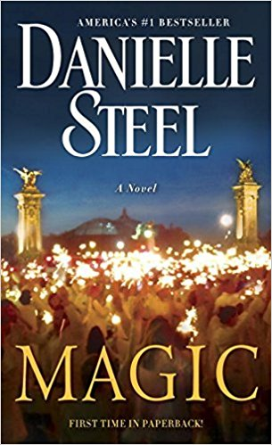
Romance
UM Libraries

Slide 11
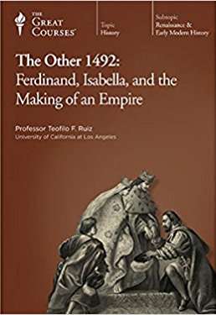
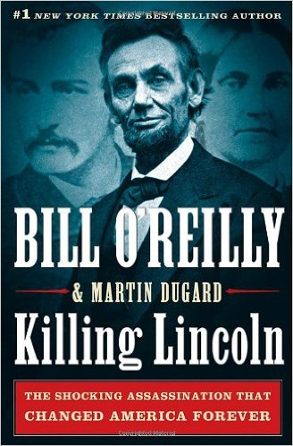
history
UM Libraries

Slide 12
UM Libraries
You can suggest titles
and authors for us to add.

